Slide 1

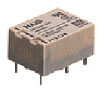
Major Applications
Slide-<number>
General Purpose Relays
  Rated by the amount of current its switch contacts can handle
  Most versions have one to eight poles and can be single or double throw
  Computers, copy machines, appliances, Security, Pool & Spa, Industrial Controls, Office Equipment
Power Relays
  Capable of handling larger power loads – 10-50 amperes or more
  single-pole or double-pole units
  Office Automation, Process Control, Automotive, Energy Management Systems, Motor Drives/Controls, Appliance Controls

Slide 2
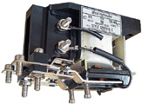

Major Applications
Slide-<number>
Contactors
  Control high voltages and currents in industrial electrical applications
  Automotive, Control Systems, overload circuitry, fluid systems
Time Delay Relays
  Delay on operate
    contacts might not open or close until some time interval after the coil has been energized
  Delay on Release
    contacts will remain in their actuated position until some interval after the power has been removed from the coil
  Interval timing
    contacts revert to their alternate position at a specific interval of time after the coil has been energized.
  Flashing light control, Engine auto start control, Conveyor belt sequence delay, Motor soft-start delay control, Furnace Safety purge control

Slide 3
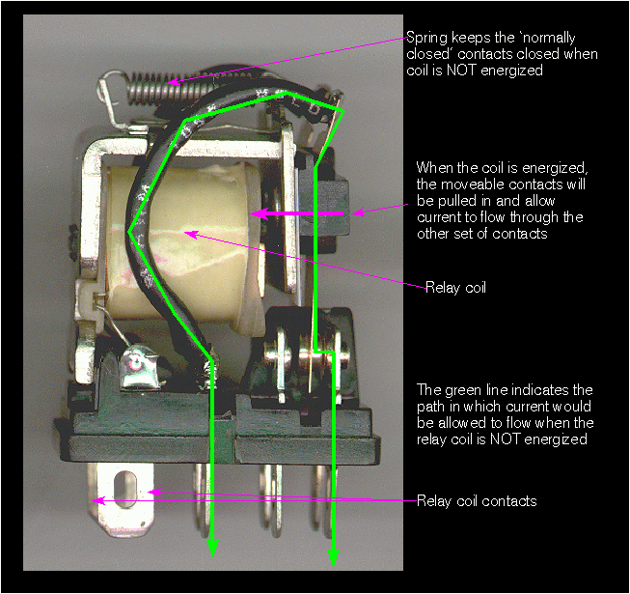
Basic working principle
Slide-<number>
http://www.bcae1.com/relays.htm

Slide 4
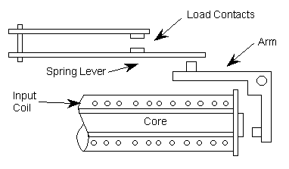
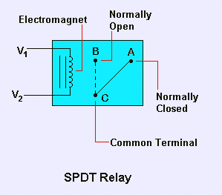
Basic working principle
Slide-<number>
The figures below demonstrate the typical electro-mechanical relay (EMR). An input voltage is applied to the coil mechanism. The input voltage magnetizes the core which pulls the arm towards it. This action causes the output contacts to touch, closing the load circuit. When the input voltage is removed, the spring lever will push the contacts away from each other, breaking the load circuit connection

Slide 5
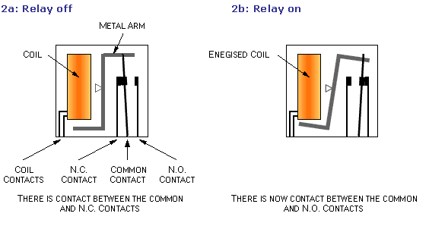
Basic working principle
Slide-<number>
In figure 2a the relay is off. The metal arm is at its rest position and so there is contact between the Normally Closed (N.C.) switch contact and the 'common' switch contact.
If a current is passed through the coil, the resulting magnetic field attracts the metal arm and there is now contact between the Normally Open (N.O.) switch contact and the common switch contact, as shown in figure 2b.

Slide 6
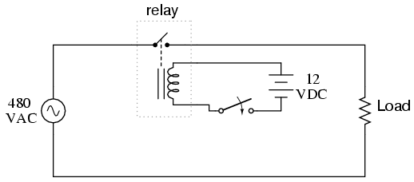
Sample configuration in application
Slide-<number>
In the above schematic, the relay's coil is energized by the low-voltage (12 VDC) source, while the single-pole, single-throw (SPST) contact interrupts the high-voltage (480 VAC) circuit. The current required to energize the relay coil will be hundreds of times less than the current rating of the contact. Typical relay coil currents are well below 1 amp, while typical contact ratings for industrial relays are at least 10 amps.

Slide 7
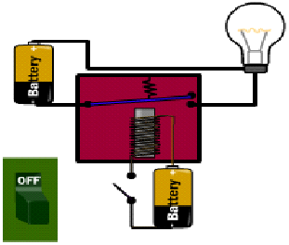
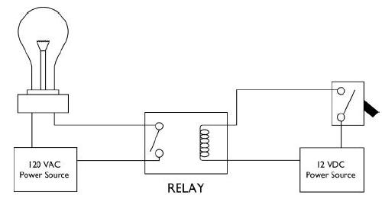
Sample configuration in application
Slide-<number>
When the light switch is turned on, the relay coil is energized by the 12 VDC Power source. The coil engages the armature, which completes the path for the light bulb to get the 120 VAC from the power source.

Slide 8
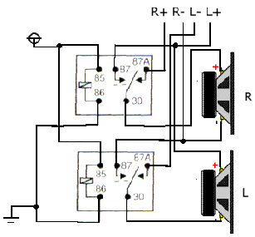
Sample configuration in application
Slide-<number>
Using the Relay to select

Slide 9
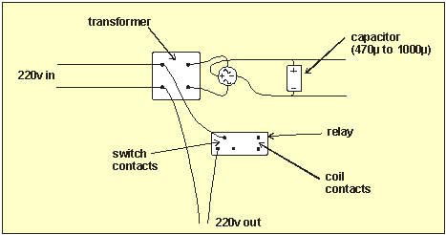
Sample configuration in application
Slide-<number>
Using the relay as a sound operated switch

Slide 10
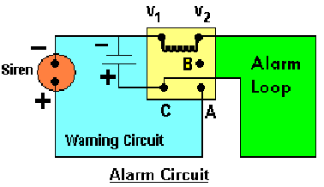
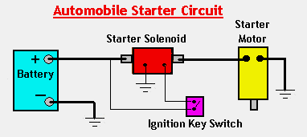
Sample configuration in application
Slide-<number>

Slide 11
Major specifications
Slide-<number>
Coil Voltage
  Pull in Voltage - minimum voltage required for the relay coil to pull the contacts together
  Drop out Voltage – voltage at which the energized coil will release the movable contacts
Current Carrying Capability of the contacts
  The current rating on relay contacts tells how much current can be passed through the contacts without damage to the contacts
Electromechanical relays have an On Resistance in the range of 100 milliohms
  The low On Resistance of the EMR allows for greater load current capability and less signal attenuation

Slide 12
Major specifications
Slide-<number>
Electromechanical relays typically have an output capacitance of less than 1 Pico Farad
Load Type
  Resistive Load - electric heaters, ranges and ovens, toasters and irons.
  Inductive Loads - power drills, electric mixers, fans, sewing machines, vacuum cleaners
  AC or DC
  High or Low Inrush - light bulb

Slide 13
Limitations
Slide-<number>
Service Life
  At the point of the contacts, oxidation breakdown occurs over extended life cycling (typically 10^6 operations)
  The relay will need to be replaced
Reliability
  When an EMR is activated, bounce occurs at the contact site
  Bounce occurs where the load circuit is flickering between open and closed
  Load design needs to be considered because of bounce
Size
  Mechanical components (coil, core, arm, contact lever arms, spring mechanism) cause physical dimension restraints
  Package size of an EMR can limit the size of a PCB design

Slide 14
Limitations
Slide-<number>
Isolation voltage
  Most EMRs are typically rated for minimum input to output isolation voltages of 1500 to 2000 VAC.
Speed
  EMRs are relatively slow devices -- typical models can switch and settle in 5 to 15 ms
  Operating speed may be too slow for some applications
Power
  Relays use more power due to the current flowing through their coil

Slide 15
Relevant issues in applications
Slide-<number>
Physical size and pin arrangement
  If you are choosing a relay for an existing PCB you will need to ensure that its dimensions and pin arrangement are suitable. You should find this information in the supplier's catalogue
Coil voltage
  The relay's coil voltage rating and resistance must suit the circuit powering the relay coil. Many relays have a coil rated for a 12V supply but 5V and 24V relays are also readily available. Some relays operate perfectly well with a supply voltage which is a little lower than their rated value
Coil resistance
  The circuit must be able to supply the current required by the relay coil
  Relay coil current = supply voltage / coil resistance

Slide 16
Relevant issues in applications
Slide-<number>
Switch ratings (voltage and current)
  The relay's switch contacts must be suitable for the circuit they are to control. The voltage rating is usually higher for AC, for example: "5A at 24V DC or 125V AC"
Relay mounting
  Socket
    Plug-in socket, plug-in terminal socket
    The spade lugs of the relay can be inserted into a mating tab or into a mating socket
  PCB mounting
    Pins of the relay are inserted through holes in the Printed Circuit Board (PBC) designed to match the pinout of the relay and wave soldered to affix the relay to the PCB
  Chassis
    Mounting ears, tabs or holes are designed as part of the relays mechanical package. Those locations typically accept nuts, bolts or screws to secure the relay to some sort of chassis. This chassis may function as a mounting location only or can also be used to provide thermal management (in higher power applications).

